Slide 1
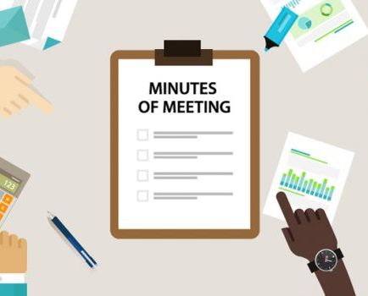
Automatically-Generated Meeting Minutes
Khalid Alharthi
Notes:
NOTE:
To change the image on this slide, select the picture and delete it. Then click the Pictures icon in the placeholder to insert your own image.

Slide 2
Agenda
Problem Statement
Approach
Dataset
Preprocessing and Feature Extraction
Modeling
Predictions
Challenges

Slide 3
Problem Statement
In business meetings, participants usually exchange ideas and make decisions. Therefore, it’s important to keep and analyze meetings content to enhance efficiency. To achieve such efficiency, one could use artificial intelligence techniques to automatically convert recorded meetings to text then apply some natural language processing such as topic modeling to extract important information.

Slide 4
Approach
Creating two models:
Speech Recognition: convert audio clips to text
Natural Language Processing (NLP): analyze the text to extract important information

Slide 5
Dataset
Common Voice is a corpus of speech data read by users on the Common Voice website. The dataset is divided into three subsets valid, invalid and other.
Valid subset: checked at least by two annotators and the majority said the audio matches the text
Invalid subset: checked at least by two annotators and the majority said the audio does not matches the text
Other subset: checked by less than two annotators or there is no majority vote
Columns | Description
filename | Relative path of the audio file
text | Supposed transcription of the audio
up_votes | Number of people who said audio matches the text
down_votes | Number of people who said audio does not match text
age | Age of the speaker
gender | Gender of the speaker
accent | Accent of the speaker
duration | Duration of the audio

Slide 6
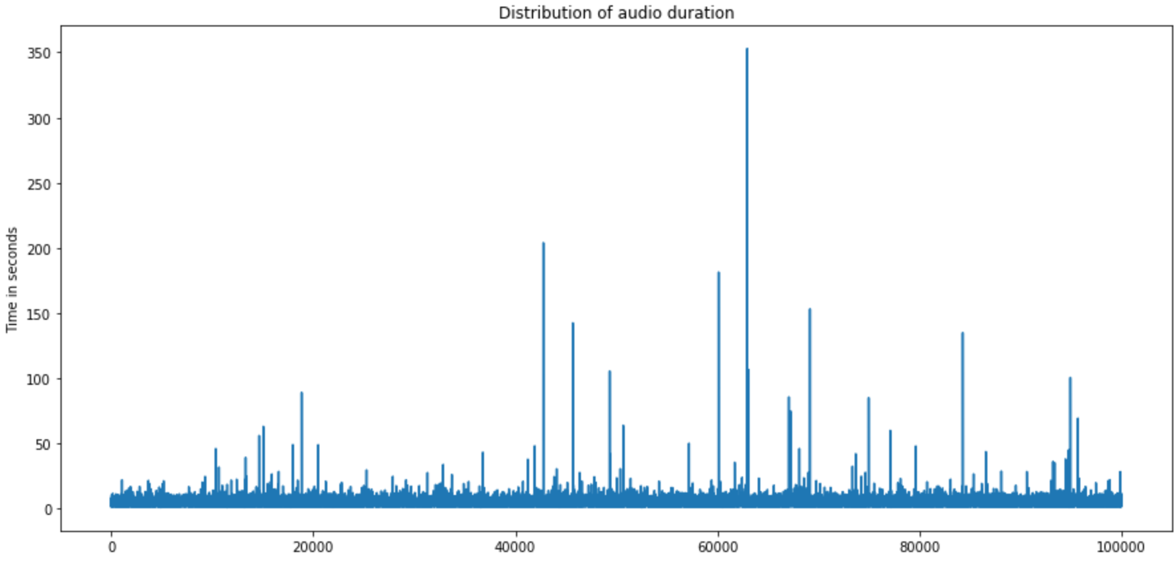
Preprocessing and Feature Extraction: Audio Length Distribution

Slide 7
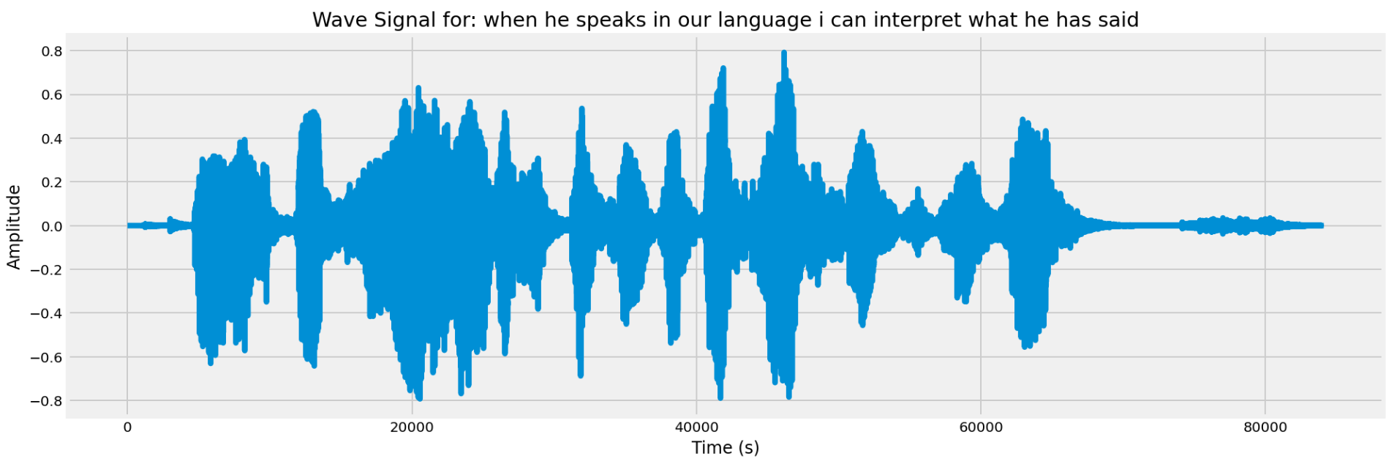
Preprocessing and Feature Extraction: Raw Wave Signal

Slide 8
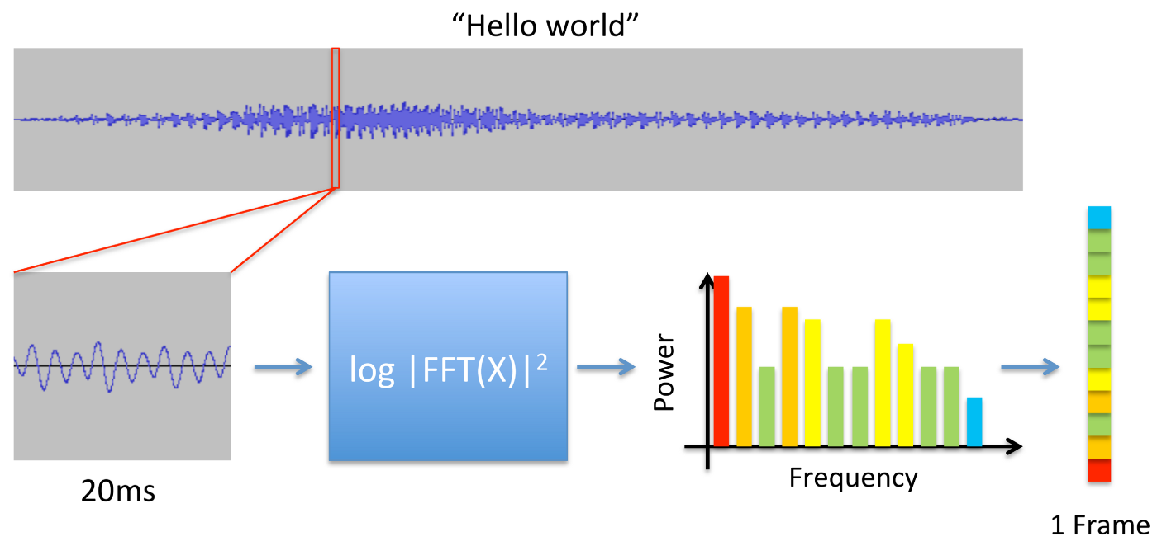
Preprocessing and Feature Extraction: MFCC Features

Slide 9
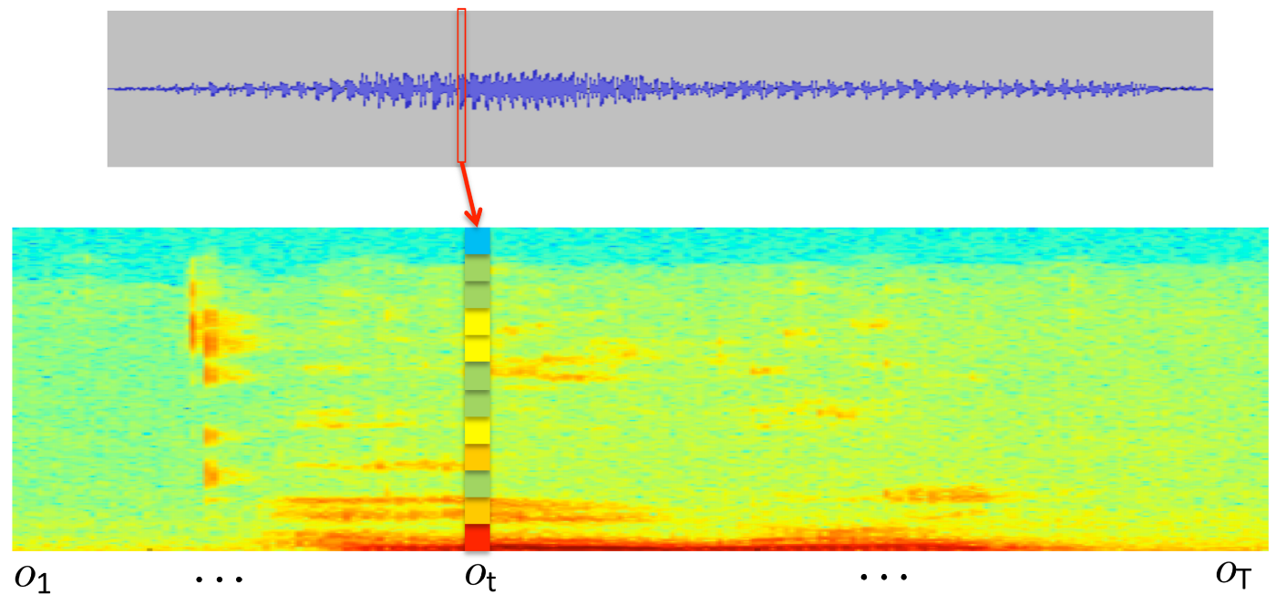
Preprocessing and Feature Extraction: MFCC Features

Slide 10
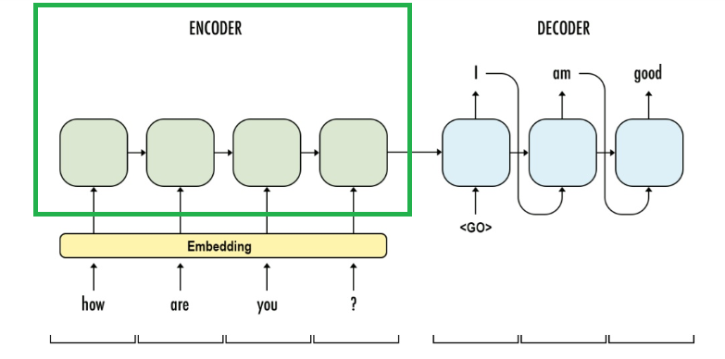
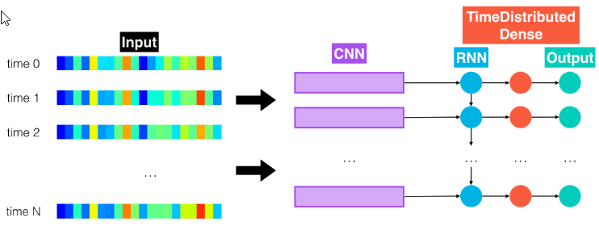
Modeling: Speech Recognition
Sequence to Sequence:

Slide 11
Results
 | Training set | Validation set
Loss | 0.1857 | 0.1984
Accuracy | 0.2103 | 0.2060

Slide 12
Predictions
Input sentence: the boy repeated his question
Decoded sentence: the boy was suddenly happy to be there at the warehs of shithtr pthing the runslaginion
-----------------------------------------------------------------------------------------------
Input sentence: the fumes from the traffic was unbearable
Decoded sentence: the boy was suddenly happy to be there at the warehs of shithtr pthing the runslags invole
----------------------------------------------------------------------------------------------------
Input sentence: about eleven i walked back to my home in maybury because nothing seemed to be happening
Decoded sentence: i want to see him do it said the chief

Slide 13
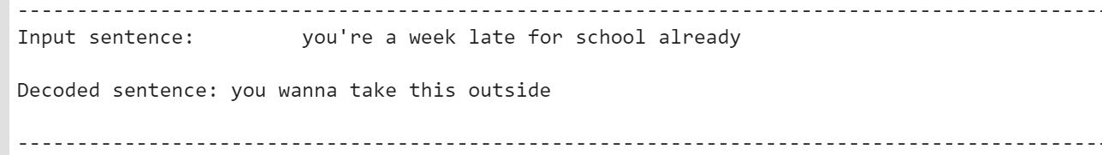
Predictions

Slide 14
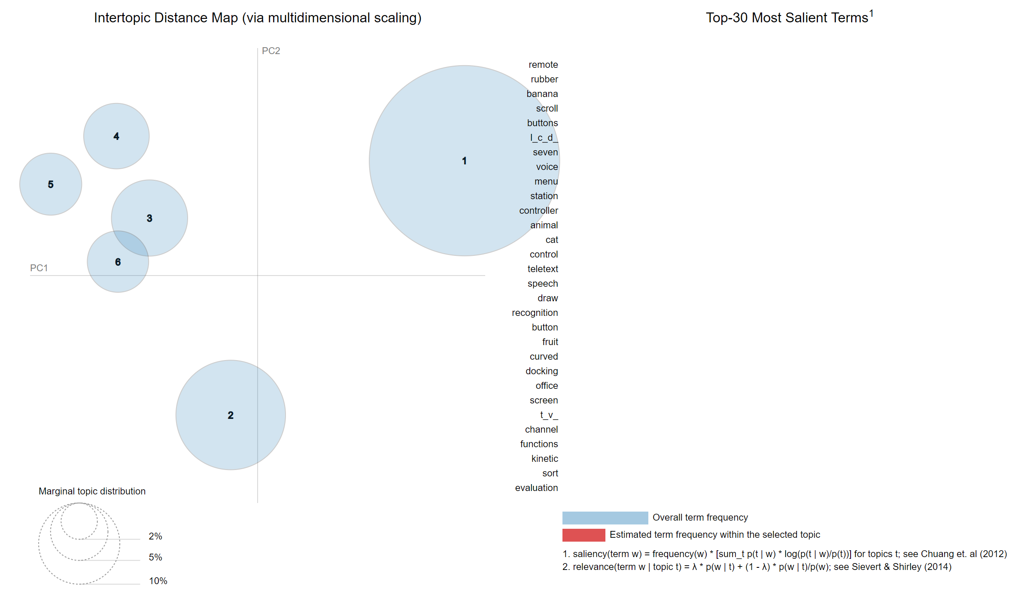
Modeling: Natural Language Processing
Topic modeling

Slide 15
Challenges
Long time to train the model
Speech Recognition domain
Deep learning required higher capacity
Google colab disconnecting

Slide 16
Feature work
Improve the accuracy
Attention-based model
Apply other NLP techniques such as sentiment analysis, text summarization … etc

Slide 17
Thank you

